Slide 1
CSE215: Database Dr. Abu Sayed Md. Latiful Hoque Professor Dept. of CSE, BUET Contact: 01556346357 asmlatifulhoque@cse.buet.ac.bd

Slide 2
Course Methodology
Each lecture will have some questions to answer
You have to sit in the lecture with white paper and black ball point pen
You have to write the answer to the paper
Every Monday after class, you will have to upload the pdf of the answer of the questions.
These submissions will carry 50% marks of class attendance the remaining 50% will be taken from zoom attendance.
There will be 2 quizzes and 1 assignment

Slide 3
Content
Storage
Indexing
Query processing
Transaction
Concurrency Control
Recovery
Parallel and Distributed Database Overview

Slide 4
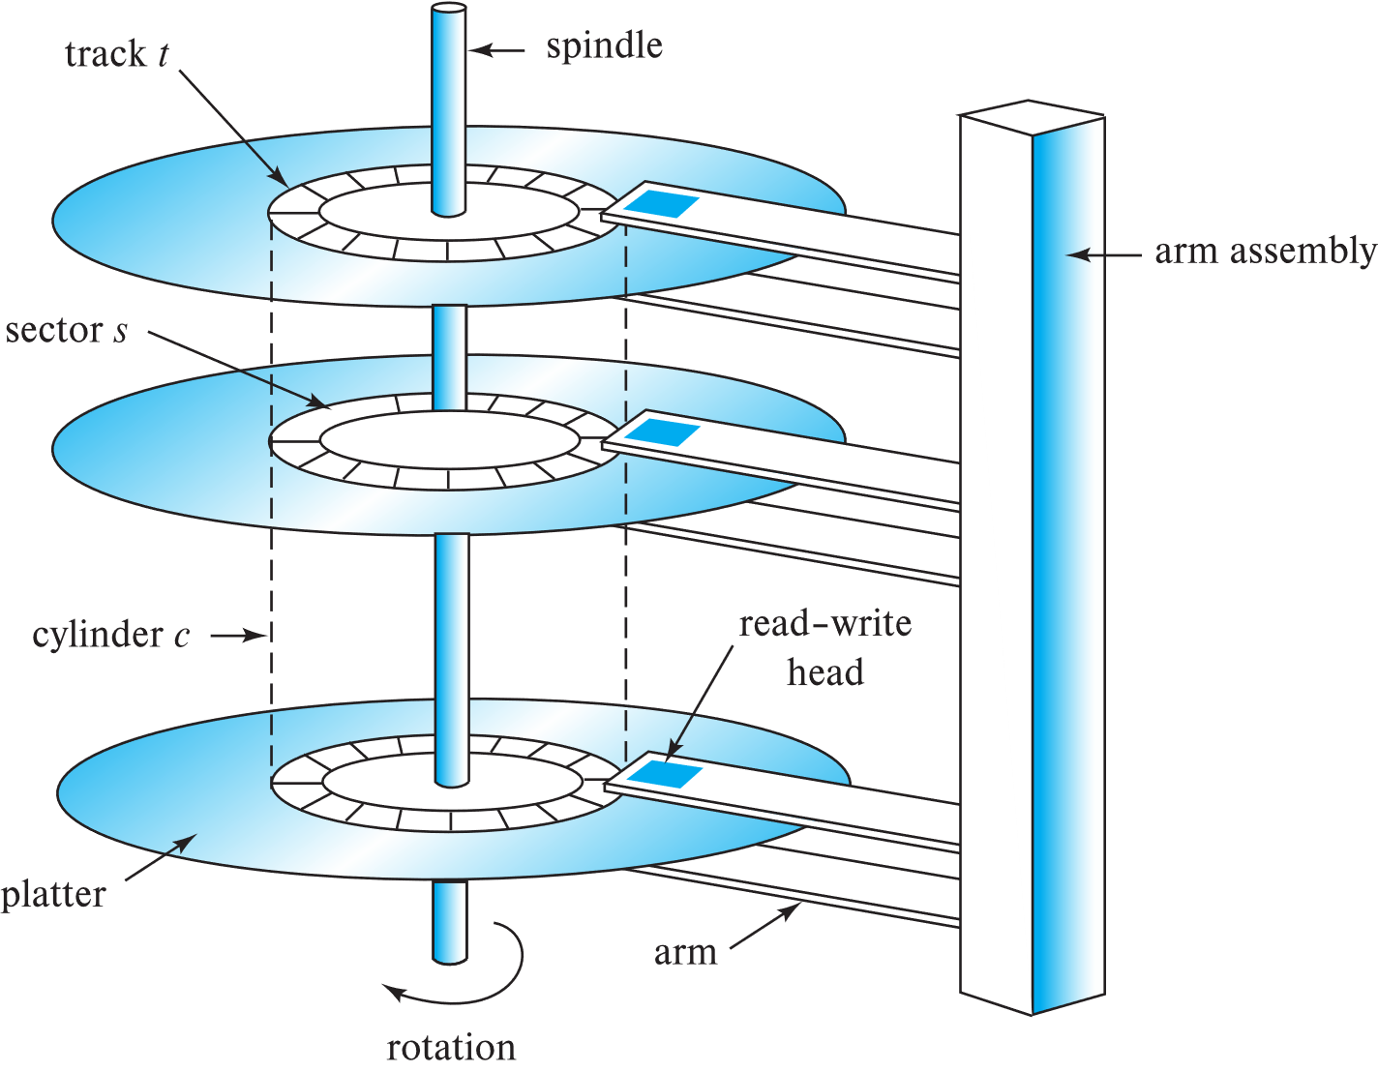
Performance Measures of Disks
Access time – the time it takes from when a read or write request is issued to when data transfer begins.
= Seek time + Rotational Latency
Seek time – time it takes to reposition the arm over the correct track.
Average seek time is 1/2 the worst case seek time.
4 to 10 milliseconds on typical disks
Rotational latency – time it takes for the sector to be accessed to appear under the head.
4 to 11 milliseconds on typical disks (5400 to 15000 r.p.m.)
Average latency is 1/2 of the above latency.
Overall latency is 5 to 20 msec depending on disk model
Schematic diagram of magnetic disk drive

Slide 5
Performance Measures of Disks
Disk block is a logical unit for storage allocation and retrieval
4 to 16 kilobytes typically
Smaller blocks: more transfers from disk
Larger blocks: more space wasted due to partially filled blocks
Sequential access pattern
Successive requests are for successive disk blocks
Disk seek required only for first block
Schematic diagram of magnetic disk drive

Slide 6
Performance Measures of Disks
Random access pattern
Successive requests are for blocks that can be anywhere on disk
Each access requires a seek
Transfer rates are low since a lot of time is wasted in seeks
I/O operations per second (IOPS)
Number of random block reads that a disk can support per second
50 to 200 IOPS on current generation magnetic disks
Schematic diagram of magnetic disk drive

Slide 7
Performance Measures of Disks
Given disk storage size as follows:
Track number range | Size (GB)
1 - 20000 | 20.48
20001 – 40000 | 10.24
The relations and the corresponding size are given below. The relations are stored consecutively in the disk platter starting from track number 1 and platter number 1.
Relation name | Size (GB)
customer | 10.24
product | 10.24
sale | 10.24
The following queries Q1 – Q3 are executed consecutively.
Query | SQL
Q1 | SELECT * FROM SALE
Q2 | SELECT * FROM CUSTOMER
Q3 | SELECT * FROM PRODUCT

Slide 8
RAID
RAID: Redundant Arrays of Independent Disks
disk organization techniques that manage a large numbers of disks, providing a view of a single disk of
high capacity and high speed by using multiple disks in parallel,
high reliability by storing data redundantly, so that data can be recovered even if a disk fails

Slide 9
Improvement in Performance via Parallelism
Two main goals of parallelism in a disk system:
Load balance multiple small accesses to increase throughput
Parallelize large accesses to reduce response time.
Improve transfer rate by striping data across multiple disks.
Bit-level striping – split the bits of each byte across multiple disks. In an array of eight disks, write bit i of each byte to disk i.
Each access can read data at eight times the rate of a single disk.
But seek/access time worse than for a single disk. (Find i^{th} Byte?)
Bit level striping is not used much any more
Student relation
101011110000000011111111…
Storing 1st byte
1
0
1
0
1
1
1
1
Storing 2nd byte
10
00
10
00
10
10
10
10

Slide 10
Improvement in Performance via Parallelism
Student relation
B0, B1, B2, B3, B4, B5, B6, B7, B8, B9, B10, B11, B12, B13
Block-level striping – with n disks, block i of a file goes to disk (i mod n) + 1
Requests for different blocks can run in parallel if the blocks reside on different disks
A request for a long sequence of blocks can utilize all disks in parallel
Block-level striping with 8 disks
B0
B1
B0
B3
B4
B5
B6
B7
After Block 7
B0
B8
B1
B9
B2
B10
B3
B11
B4
B12
B5
B13
B6
B7

Slide 11
RAID Levels
RAID Level 0
Example: You need 8TB of storage and there are available of 2TB disks.
How many disks will be needed for this storage system in RAID 0?
Different RAID organizations, or RAID levels, have differing cost, performance and reliability characteristics
RAID Level 0: Block striping; non-redundant.
Used in high-performance applications where data loss is not critical.
D0 D1 D2 D3
You have to store student relation file (B0, B1, B2, B3, B4, B6, B7, B8, B9) into the storage system of RAID 0.
How?
D0 D1 D2 D3
B0
B4
B8
B1
B5
B9
B2
B6
B3
B7

Slide 12
RAID Levels
RAID Level 1 (Mirroring)
RAID Level 1: Mirrored disks with block striping
Offers best write performance.
Popular for applications such as storing log files in a database system.
Example: You need 8TB of storage and there are available of 2TB disks.
How many disks will be needed for this storage system in RAID 1?
D0 D1 D2 D3
D4 D5 D6 D7
DATA
MIRROR DISK
You have to store student relation file (B0, B1, B2, B3, B4, B5, B6, B7, B8, B9) into the storage system of RAID 1.
How?
D0 D1 D2 D3
B0
B4
B8
B1
B5
B9
B2
B6
B3
B7
D4 D5 D6 D7
B0
B4
B8
B1
B5
B9
B2
B6
B3
B7

Slide 13
Improvement of Reliability via Redundancy
Redundancy – store extra information that can be used to rebuild information lost in a disk failure
E.g., Mirroring (or shadowing)
Duplicate every disk. Logical disk consists of two physical disks.
Every write is carried out on both disks
Reads can take place from either disk
If one disk in a pair fails, data still available in the other
Data loss would occur only if a disk fails, and its mirror disk also fails before the system is repaired
Probability of combined event is very small
Except for dependent failure modes such as fire or building collapse or electrical power surges

Slide 14
RAID Levels (Cont.)
Parity blocks: Parity block j stores XOR of bits from block j of each disk
When writing data to a block j, parity block j must also be computed and written to disk
Can be done by using old parity block, old value of current block and new value of current block (2 block reads + 2 block writes)
Or by recomputing the parity value using the new values of blocks corresponding to the parity block
More efficient for writing large amounts of data sequentially
To recover data for a block, compute XOR of bits from all other blocks in the set including the parity block

Slide 15
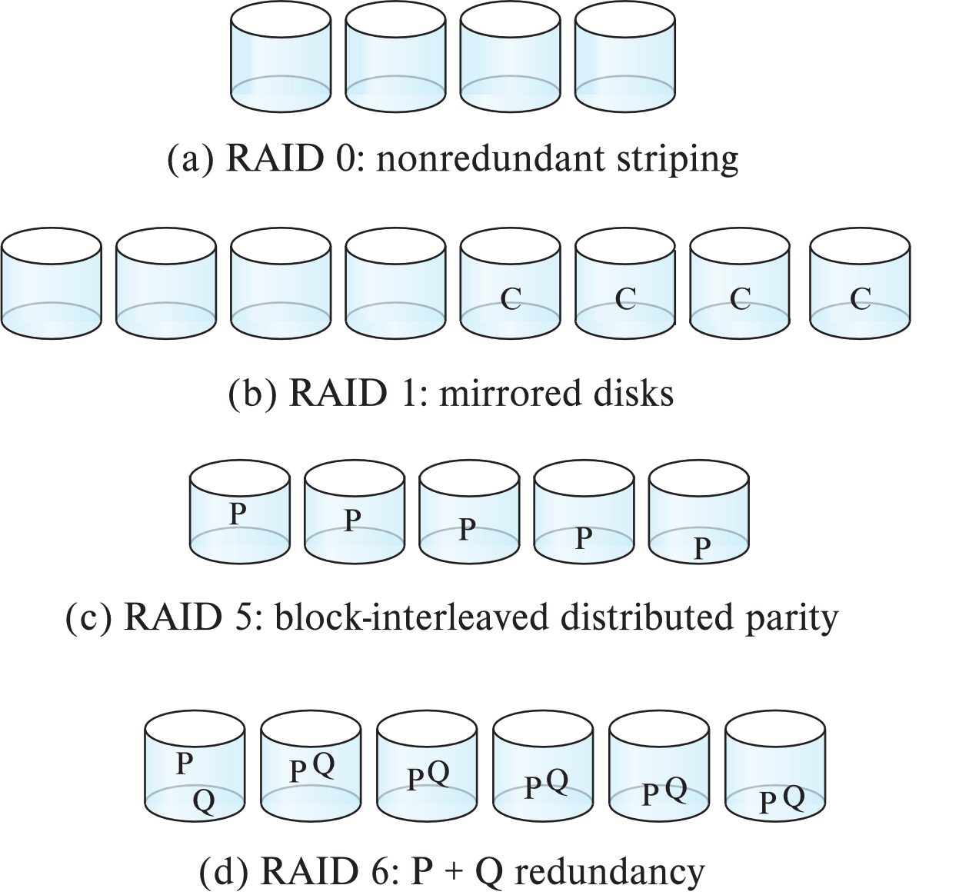
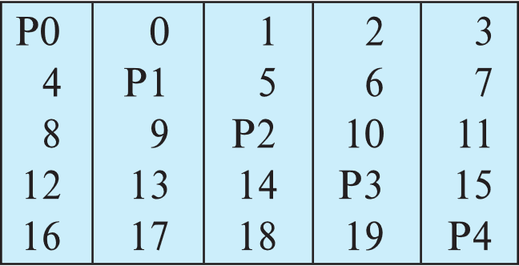
RAID Levels (Cont.)
RAID Level 5: Block-Interleaved Distributed Parity; partitions data and parity among all N + 1 disks, rather than storing data in N disks and parity in 1 disk.
E.g., with 5 disks, parity block for nth set of blocks is stored on disk (n mod 5) + 1, with the data blocks stored on the other 4 disks.

Slide 16
RAID Levels (Cont.)
RAID Level 5 (Cont.)
Block writes occur in parallel if the blocks and their parity blocks are on different disks.
RAID Level 6: P+Q Redundancy scheme; similar to Level 5, but stores two error correction blocks (P, Q) instead of single parity block to guard against multiple disk failures.
Better reliability than Level 5 at a higher cost
Becoming more important as storage sizes increase

Slide 17
RAID Levels (Cont.)
Other levels (not used in practice):
RAID Level 2: Memory-Style Error-Correcting-Codes (ECC) with bit striping.
RAID Level 3: Bit-Interleaved Parity
RAID Level 4: Block-Interleaved Parity; uses block-level striping, and keeps a parity block on a separate parity disk for corresponding blocks from N other disks.
RAID 5 is better than RAID 4, since with RAID 4 with random writes, parity disk gets much higher write load than other disks and becomes a bottleneck

Slide 18
RAID FAULT TOLERANCE
The chance that some disk out of a set of N disks will fail is much higher than the chance that a specific single disk will fail.
E.g., a system with 100 disks, each with MTTF of 100,000 hours (approx. 11 years), will have a system MTTF of 1000 hours (approx. 41 days) Probability of Failure of one disk = (1/100000)*100 = 1/1000
MTTF = 1000 hours
Techniques for using redundancy to avoid data loss are critical with large numbers of disks
Mean time to data loss depends on mean time to failure, and mean time to repair
E.g., MTTF of 100,000 hours, mean time to repair of 10 hours gives mean time to data loss of 500*10⁶ hours (or 57,000 years) for a mirrored pair of disks (ignoring dependent failure modes)

Slide 19
Choice of RAID Level
Factors in choosing RAID level
Monetary cost
Performance: Number of I/O operations per second, and bandwidth during normal operation
Performance during failure
Performance during rebuild of failed disk
Including time taken to rebuild failed disk
RAID 0 is used only when data safety is not important
E.g., data can be recovered quickly from other sources

Slide 20
Choice of RAID Level (Cont.)
Level 1 provides much better write performance than level 5
Level 5 requires at least 2 block reads and 2 block writes to write a single block, whereas Level 1 only requires 2 block writes
Level 1 had higher storage cost than level 5
Level 5 is preferred for applications where writes are sequential and large (many blocks), and need large amounts of data storage
RAID 1 is preferred for applications with many random/small updates
Level 6 gives better data protection than RAID 5 since it can tolerate two disk (or disk block) failures
Increasing in importance since latent block failures on one disk, coupled with a failure of another disk can result in data loss with RAID 1 and RAID 5.

Slide 21
Hardware Issues
Software RAID: RAID implementations done entirely in software, with no special hardware support
Hardware RAID: RAID implementations with special hardware
Use non-volatile RAM to record writes that are being executed
Beware: power failure during write can result in corrupted disk
E.g., failure after writing one block but before writing the second in a mirrored system
Such corrupted data must be detected when power is restored
Recovery from corruption is similar to recovery from failed disk
NV-RAM helps to efficiently detected potentially corrupted blocks
Otherwise all blocks of disk must be read and compared with mirror/parity block

Slide 22
Hardware Issues (Cont.)
Latent failures: data successfully written earlier gets damaged
can result in data loss even if only one disk fails
Data scrubbing:
continually scan for latent failures, and recover from copy/parity
Hot swapping: replacement of disk while system is running, without power down
Supported by some hardware RAID systems,
reduces time to recovery, and improves availability greatly
Many systems maintain spare disks which are kept online, and used as replacements for failed disks immediately on detection of failure
Reduces time to recovery greatly
Many hardware RAID systems ensure that a single point of failure will not stop the functioning of the system by using
Redundant power supplies with battery backup
Multiple controllers and multiple interconnections to guard against controller/interconnection failures

Slide 23
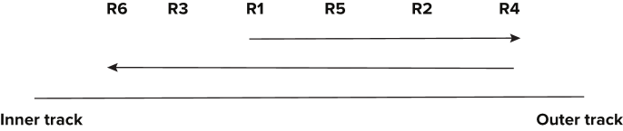
Optimization of Disk-Block Access
Buffering: in-memory buffer to cache disk blocks
Read-ahead: Read extra blocks from a track in anticipation that they will be requested soon
Disk-arm-scheduling algorithms re-order block requests so that disk arm movement is minimized
elevator algorithm

Slide 24
Optimization of Disk-Block Access
Buffering: in-memory buffer to cache disk blocks
Read-ahead: Read extra blocks from a track in anticipation that they will be requested soon
Disk-arm-scheduling algorithms re-order block requests so that disk arm movement is minimized
elevator algorithm
R6
R3
R1
R5
R2
R4
Inner track
Outer track

Slide 25
Optimization of Disk Block Access (Cont.)
File organization
Allocate blocks of a file in as contiguous a manner as possible
Allocation in units of extents
Files may get fragmented
E.g., if free blocks on disk are scattered, and newly created file has its blocks scattered over the disk
Sequential access to a fragmented file results in increased disk arm movement
Some systems have utilities to defragment the file system, in order to speed up file access
Non-volatile write buffers

Slide 26
Magnetic Tapes
Hold large volumes of data and provide high transfer rates
Few GB for DAT (Digital Audio Tape) format, 10-40 GB with DLT (Digital Linear Tape) format, 100 GB+ with Ultrium format, and 330 GB with Ampex helical scan format
Transfer rates from few to 10s of MB/s
Tapes are cheap, but cost of drives is very high
Very slow access time in comparison to magnetic and optical disks
limited to sequential access.
Some formats (Accelis) provide faster seek (10s of seconds) at cost of lower capacity
Used mainly for backup, for storage of infrequently used information, and as an off-line medium for transferring information from one system to another.
Tape jukeboxes used for very large capacity storage
Multiple petabyes (10¹⁵ bytes)

Slide 27
SSD Performance Metrics
Random reads/writes per second
Typical 4 KB reads: 10,000 reads per second (10,000 IOPS)
Typical 4KB writes: 40,000 IOPS
SSDs support parallel reads
Typical 4KB reads:
100,000 IOPS with 32 requests in parallel (QD-32) on SATA
350,000 IOPS with QD-32 on NVMe PCIe
Typical 4KB writes:
100,000 IOPS with QD-32, even higher on some models
Data transfer rate for sequential reads/writes
400 MB/sec for SATA3, 2 to 3 GB/sec using NVMe PCIe
Hybrid disks: combine small amount of flash cache with larger magnetic disk

Slide 28
Storage Class Memory
3D-XPoint memory technology pioneered by Intel
Available as Intel Optane
SSD interface shipped from 2017
Allows lower latency than flash SSDs
Non-volatile memory interface announced in 2018
Supports direct access to words, at speeds comparable to main-memory speeds

